Slide 1


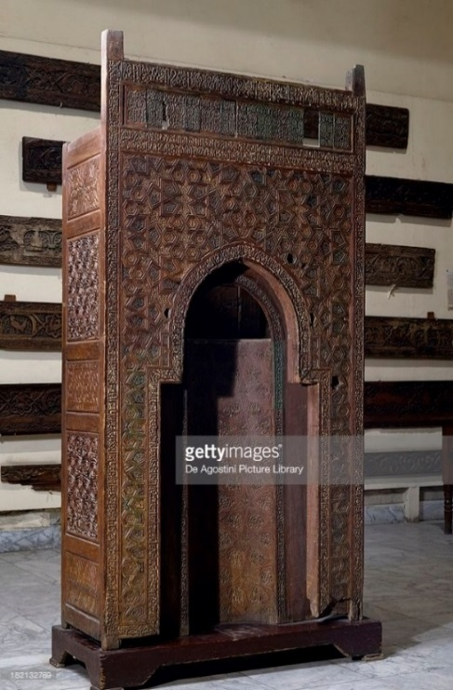
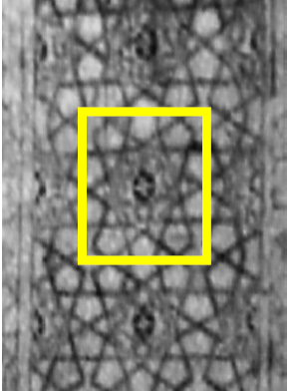
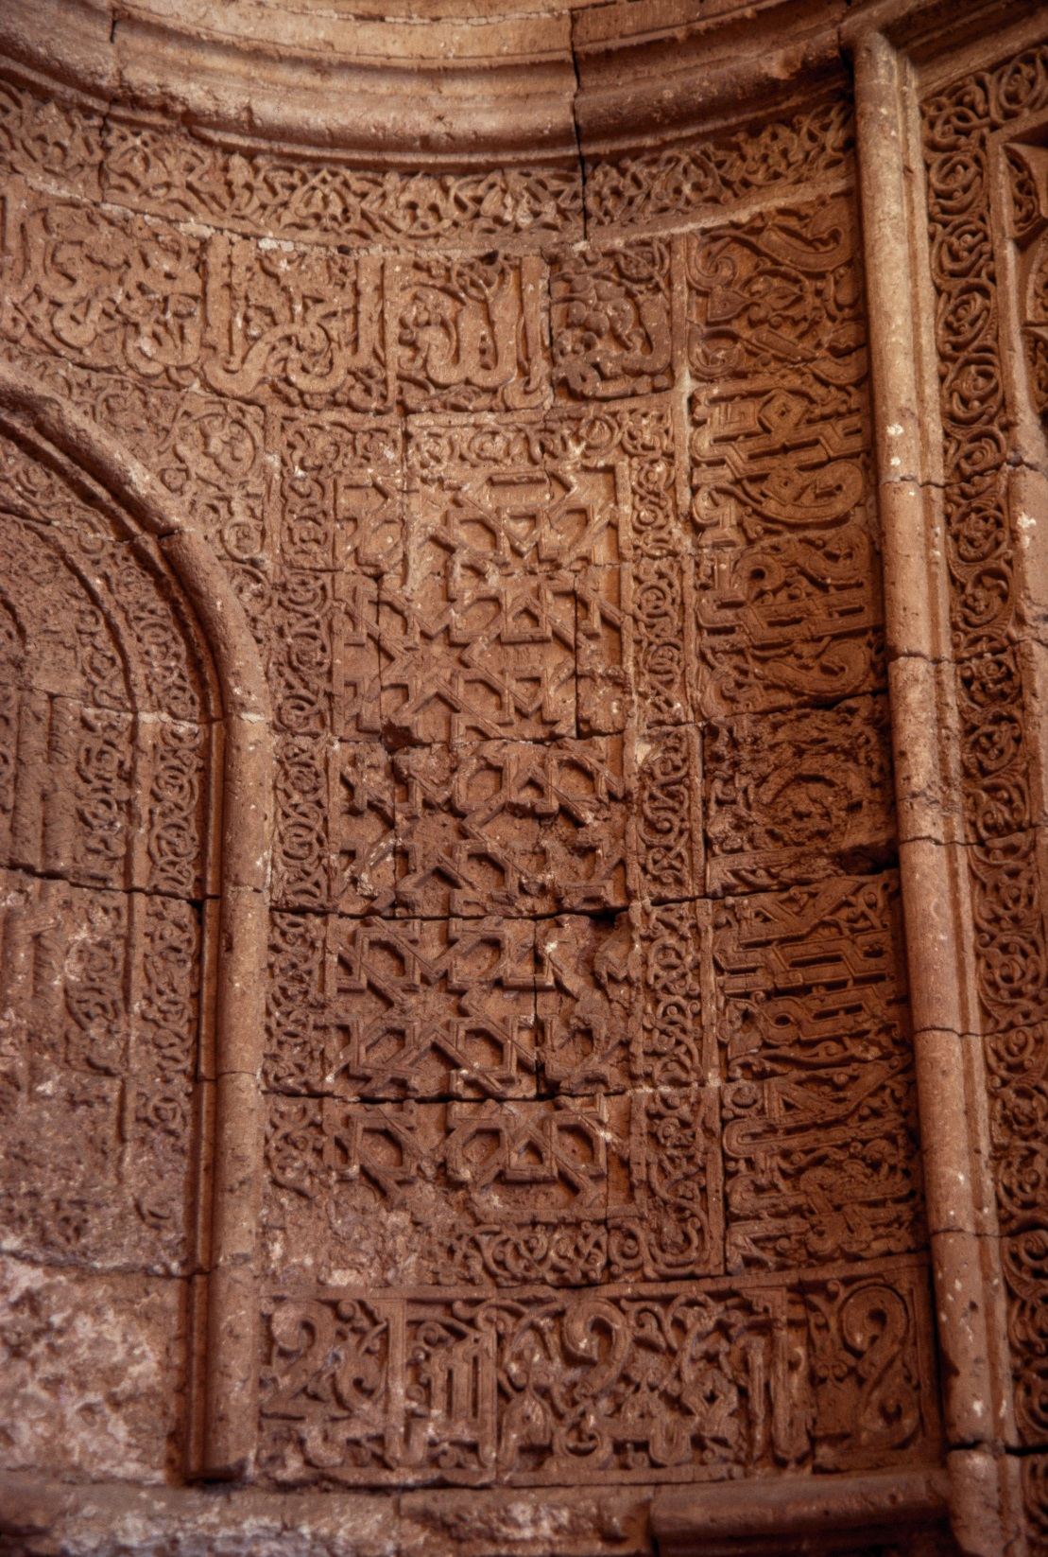
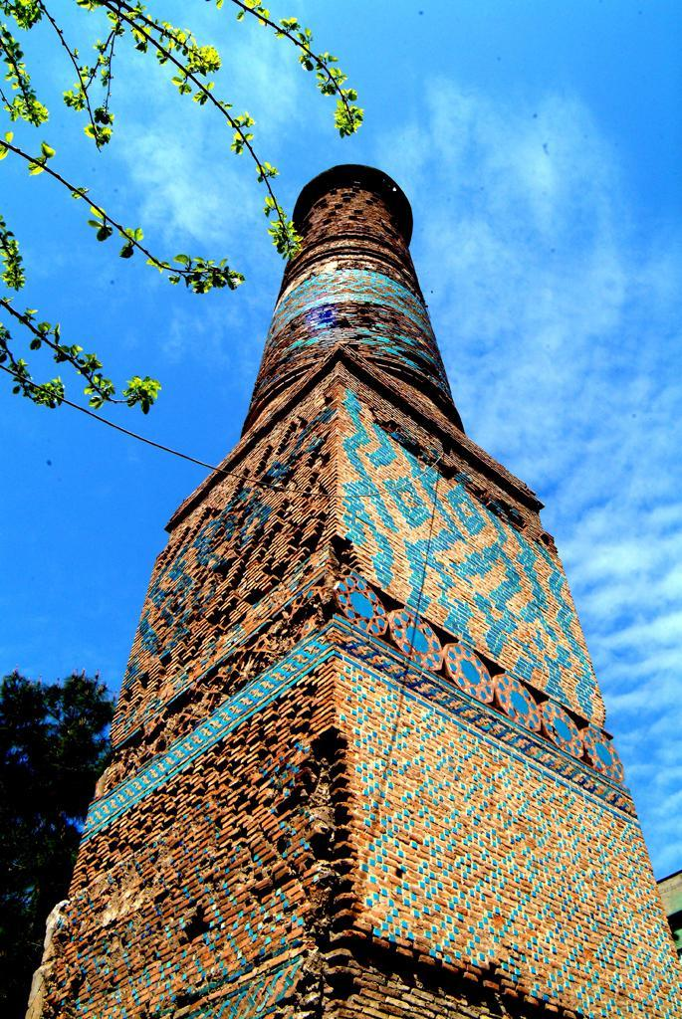
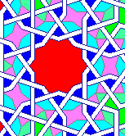
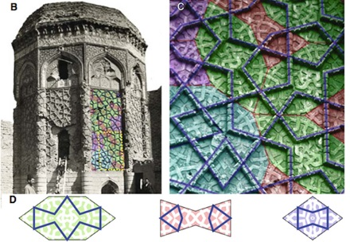
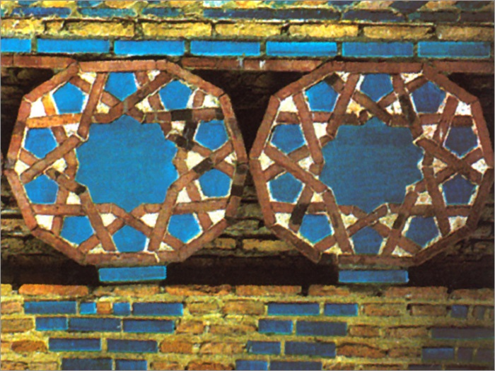
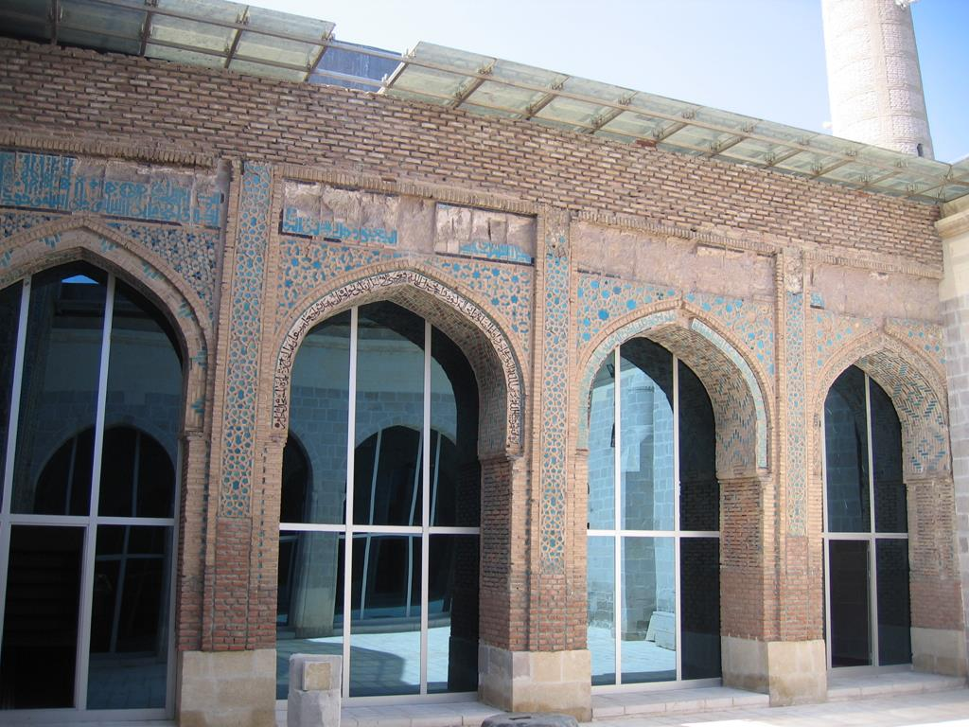
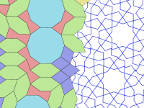
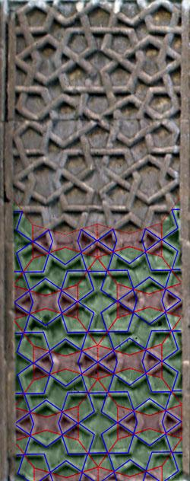
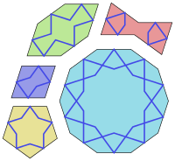
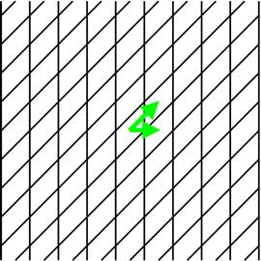
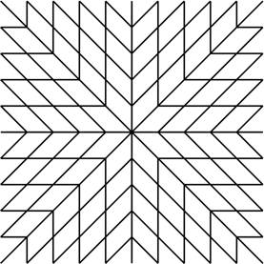
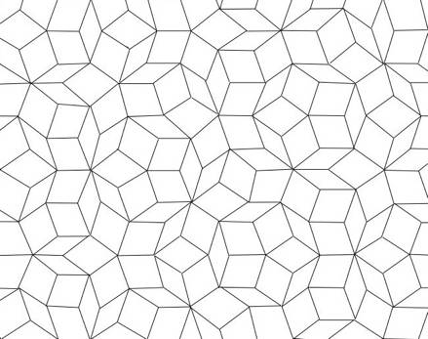
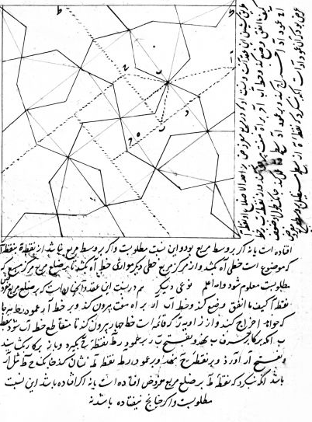
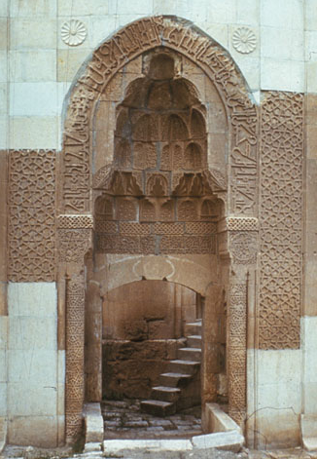
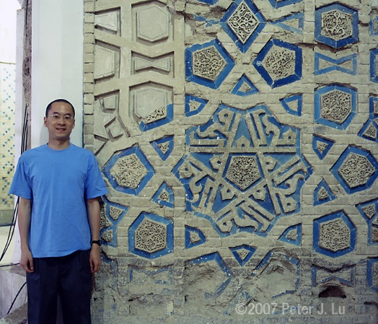
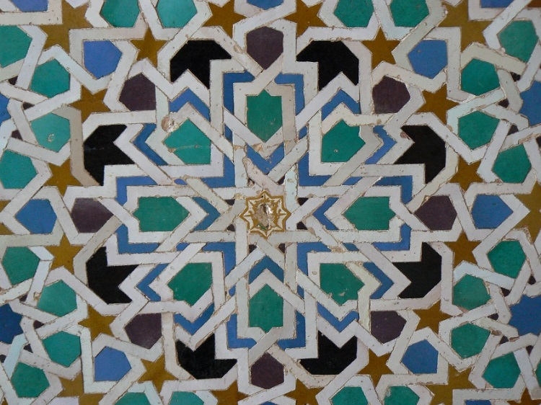
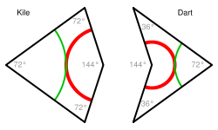
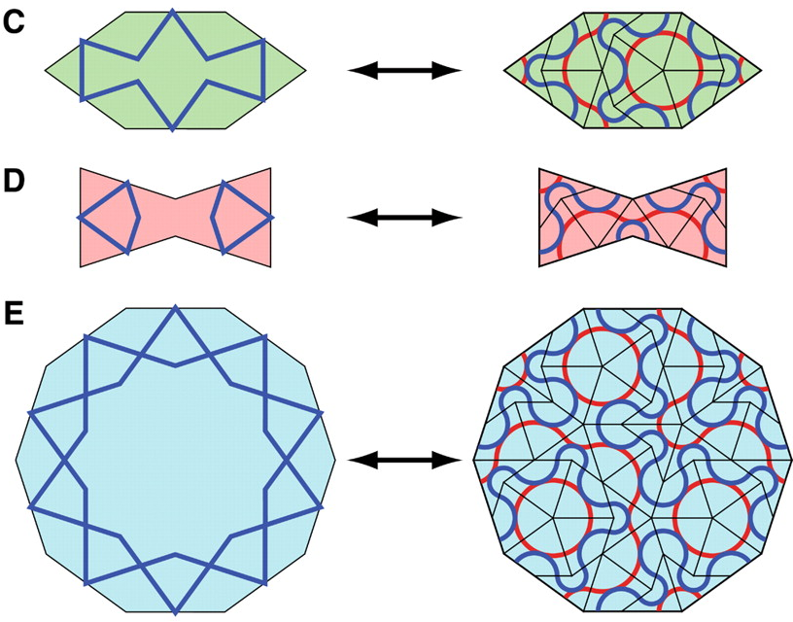
Girih tiling
Presenter: Jurgen Xhafaj Advisor: Dr. Al-Hasan
Cairo, Egypt (1133)
Ardistan, Iran (1160)
Mardin, Turkey (1204)
Abstract
Our Findings
Our research addresses a type of tiling used initially in Islamic architecture. Girih tiling dates back to 12th century, and consists of a set of five tiles. Previous research by Peter Lu and others has given their shapes and properties, but there has not been enough emphasis on how, where, and when did the artisans learn to use this kind of tiling. During our research, we studied gathered information about girih tiling, studied the oldest buildings displaying this tiling as well as the mathematicians who contributed in their design; finally managing to find the answers to aforementioned questions.
Geometry has been used a lot in the construction of intricate designs which are present in buildings, tiles and fabric patterns. The history of geometric design contains many instances of collaborations between mathematicians and artists and the continuing evolution of Islamic ornamentation is no exception. [RT]
Reconstruction with Girih tiles
Maragha, Iran (1196)
Siirt, Turkey (1129)
Architectural works: Where and when
The Great Seljuk Empire was created in 1037, and at the time, they paid a lot of attention to the architecture and designs of decorating objects, which usually were religious ones. When the Great Seljuq Empire ceased to exist, many small dynasties managed to occupy territories in Turkey, Syria and Mesopotamia. During the conquests, the Seljuks spread out their knowledge, but also imported foreign knowledge in mathematics. This mixture helped in designing patterns (like girih) to decorate their buildings. During our research, several buildings were analyzed for girih tiling, and a list of the most important architectural works is shown below:
Introduction
Malatya, Turkey (1200)
A tiling is a collection of subsets of the plane (i.e. tiles), which cover the plane without gaps or overlaps. The conventional view holds that girih (geometric star-and-polygon) patterns in medieval Islamic architecture were conceived by their designers as a network of zigzagging lines. Girih tiling is aperiodic: it contains a set of tiles which can only tile the plane in a non-periodic manner. [GS]
The girih tiles also have decorating lines printed on them.
It is generally believed that girih designs were constructed by using only a straightedge and a compass. The Topkapi Scroll (97 foot long) contains design templates that were manually copied by craftsmen. Another way of spreading the knowledge was by preparing books and having the craftsmen read them.
Girih tiles and girih lines
Abul Wafa al Buzjani’s contributions cover both theoretical and practical aspects of this science. His practical textbook on geometry, “A Book on Those Geometric Constructions Which Are Necessary for a Craftsman” written some time between 961 and 976 was the most famous work in that area.
A sketch from al-Kashı of different elements
1→ Great Mosque of Siirt – 1129 – Siirt, Turkey
2→ Mausoleum of Sayyida Ruqayya -- 1133 -- Cairo, Egypt
3→ The Seljuk Congregational Mosque -- (1160 AD) -- in Ardistan, Iran
4→ Gunbad I Kabud -- 1196 – Maragha, Iran
5→ The Mausoleum of Mama Hatun –12th cent.—Tercan, Turkey
6→ Kızıltepe -- 1184->1204 -- Mardin, Turkey
7→ Great Mosque -- 1200 -- in Malatya, Turkey
8→ The Alhambra Palace -- 14th cent. -- Granada, Spain
Periodic
Non-Periodic
Aperiodic
“On Interlocking Similar or Congruent Figures” is the only known practical manual that provides “how-to” instructions for drawing 2-D girih patterns. The document is anonymous, but the way that it is written suggests that the author simply put down notes from some conversazioni, suggesting that it wasn’t the work of a single person. [YDS]
The five Girih tiles
Using online tools, we were able to reproduce some of the girih patterns.
Previous Research
When Peter J. Lu visited Uzbekistan as a Harvard University graduate student in 2005, he was fascinated by the beautiful and intricate geometric "girih" patterns on the 800-year-old buildings there, and he wanted to know how ancient artisans had created them.
References
Tercan, Turkey (end of 12th century)
Peter Lu in Iran, 2007
Drawing from the interlocking manual
[LU] Lu, Peter J., and Steinhardt, Paul J. "Decagonal and quasi-crystalline tilings in medieval Islamic
architecture." Science Magazine 315.5815 (2007): 1106-1110.
[YDS] Yvonne Dold-Samplonius, “The Topkapi Scroll—Geometry and Ornament in Islamic Architecture: Topkapi
Palace Library”; By Gülru Necipoǧlu., Historia Mathematica, Volume 26, Issue 2, May 1999, P. 166-172
[GS] Grunbaum, Shephard, ”Tilings and Patterns”, 1987, Chapter 3.8
[RT] Tennant, Raymond “Islamic Constructions: The Geometry Needed by Craftsmen”. Zayed University, UAE
[AO] Özdural, Alpay “Mathematics and Art: Connections between Theory and Practice in the Medieval Islamic
World”, Historia Mathematica, Vol. 27, pp. 171-201, 2000.
Özdural, Alpay “Omar Khayyam, Mathematicians, and ‘Conversazioni’ with Artisans”. Journal of the Society of
Architectural Historians, Vol. 54, No. 1 (Mar., 1995)
[HV] van den Hoeven, van der Veen; “Muqarnas & Mathematics in Islamic Arts”. Utrecht University 2010
Lu found out that Penrose tiling had been used as the foundation for complicated, non-repeating patterns. Lu's research shows that “these patterns had been applied long before Penrose's discovery: in fact, more than 500 years earlier” [LU]. Lu also figured out that the girih tiles could be broken up into the kites and darts of Penrose tiles. A Penrose tiling is a non-periodic tiling generated by an aperiodic set of prototiles.
However, only people with an advanced grasp of geometry could have made such elaborate, interlocking designs used in girih tiling. During the 10th Century, the Islamic mathematician and astronomer Abu’l-Wafā, participated in meetings in Baghdad, which served as a forum for artisans and mathematician to discuss methods for constructing ornamental designs in wood, tile, and other materials. [AO]
Inspired by earlier designs, Al Kashi started to conduct research on how two-dimensional designs were transferred to three-dimensional structures in 1420 and continued until he died in 1429. [HV]
http://www.peterlu.org/
http://mathforum.org/
http://www.scienceu.com/geometry/
http://islamic-arts.org/tag/girih-tiles/
https://www.saudiaramcoworld.com
https://www.sciencenews.org/
https://classes.yale.edu/
http://artofislamicpattern.com/
http://www.livescience.com/
http://www.scientificamerican.com/
http://www.muslimheritage.com/
http://archnet.org/
http://islamichistory.org/
http://www.tessellations.org/
http://www.360cities.net/
http://www-history.mcs.st-and.ac.uk/
http://www.islam4theworld.net/
http://www.britannica.com/
http://lostislamichistory.com/
http://siirtmuftulugu.gov.tr/
http://www.e-tarih.org/
http://www.kulturbilinci.org/
http://www.frmartuklu.org/
http://www.gezginturk.org/
Granada, Spain (1333)
Penrose tiles
Breaking down Girih tiles into Penrose ones

